Slide 1
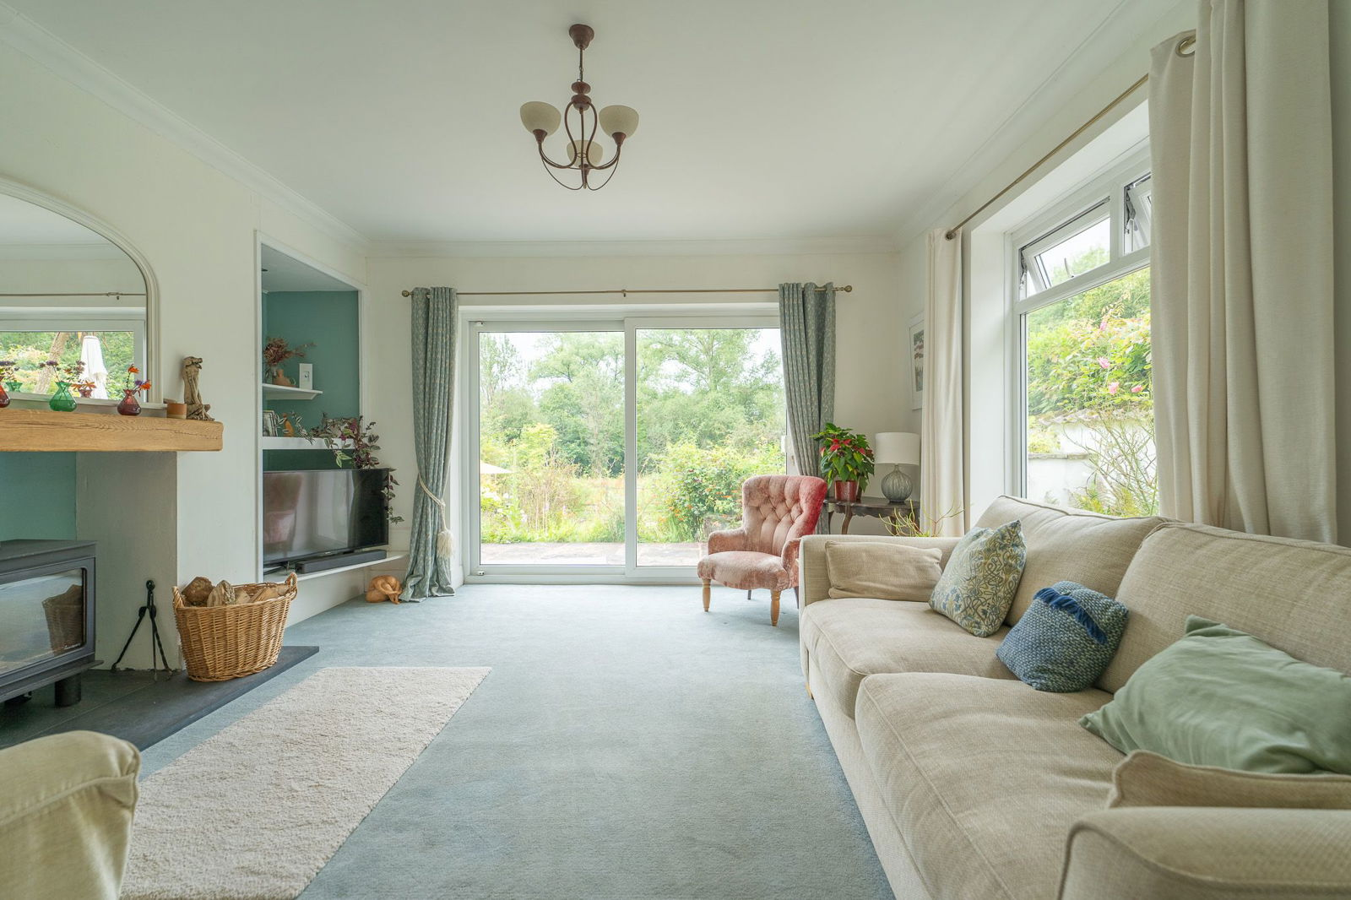
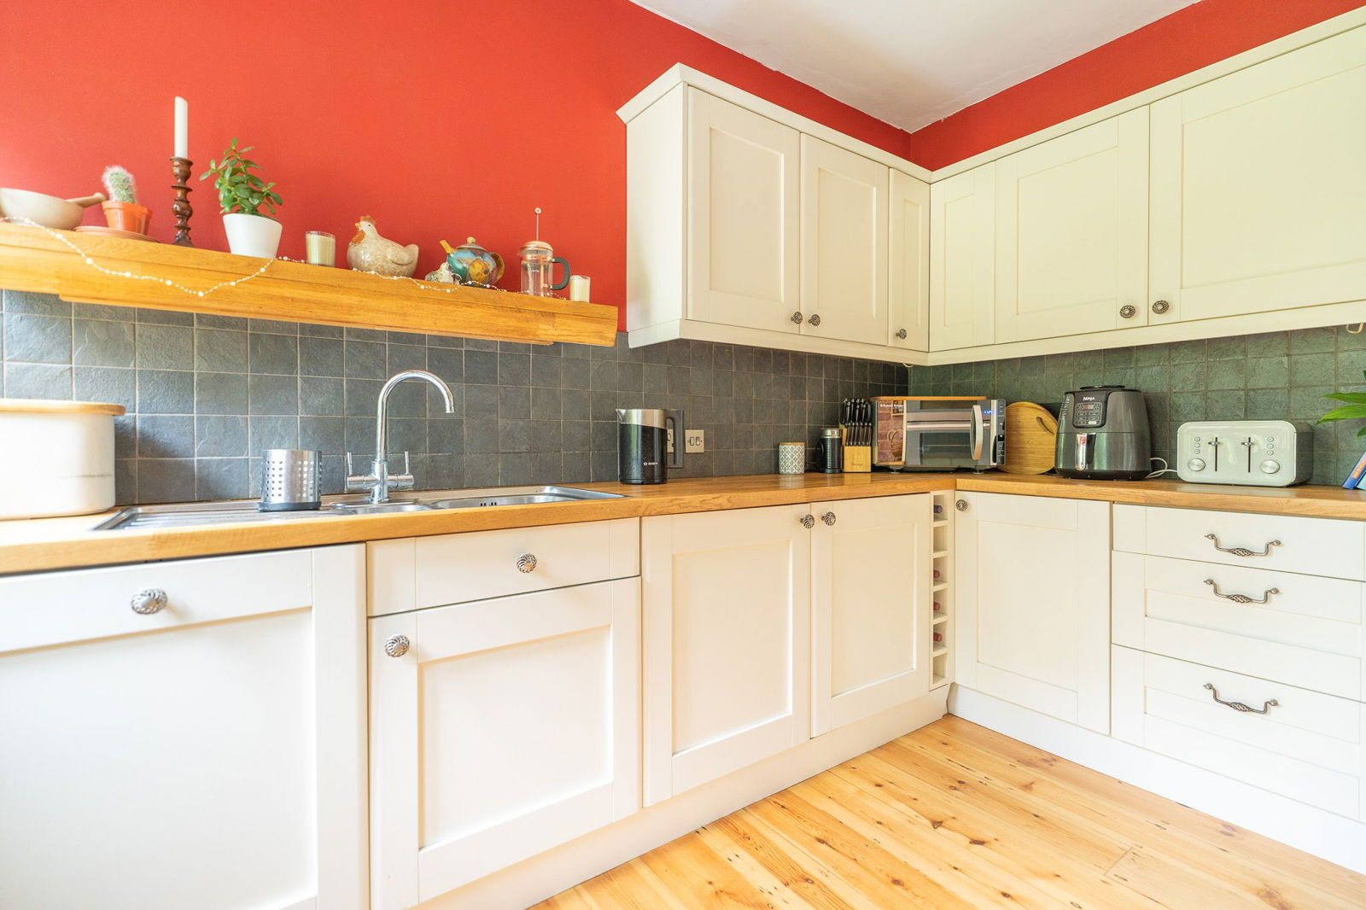
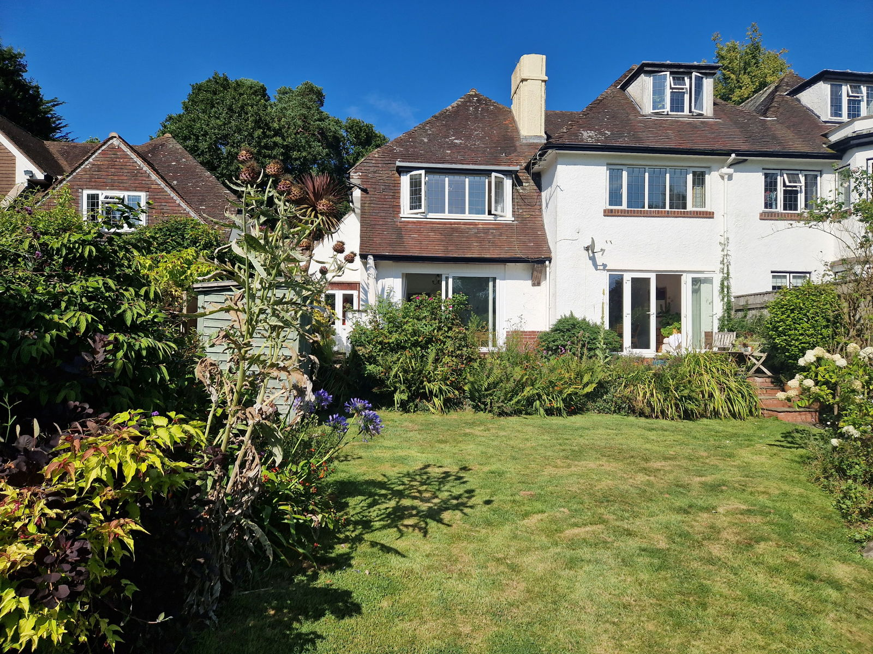
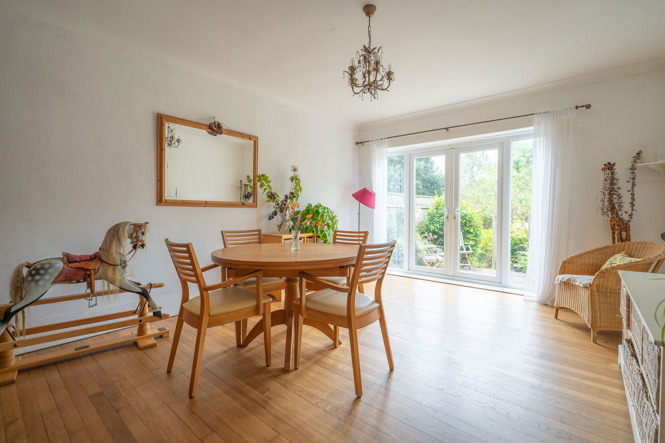
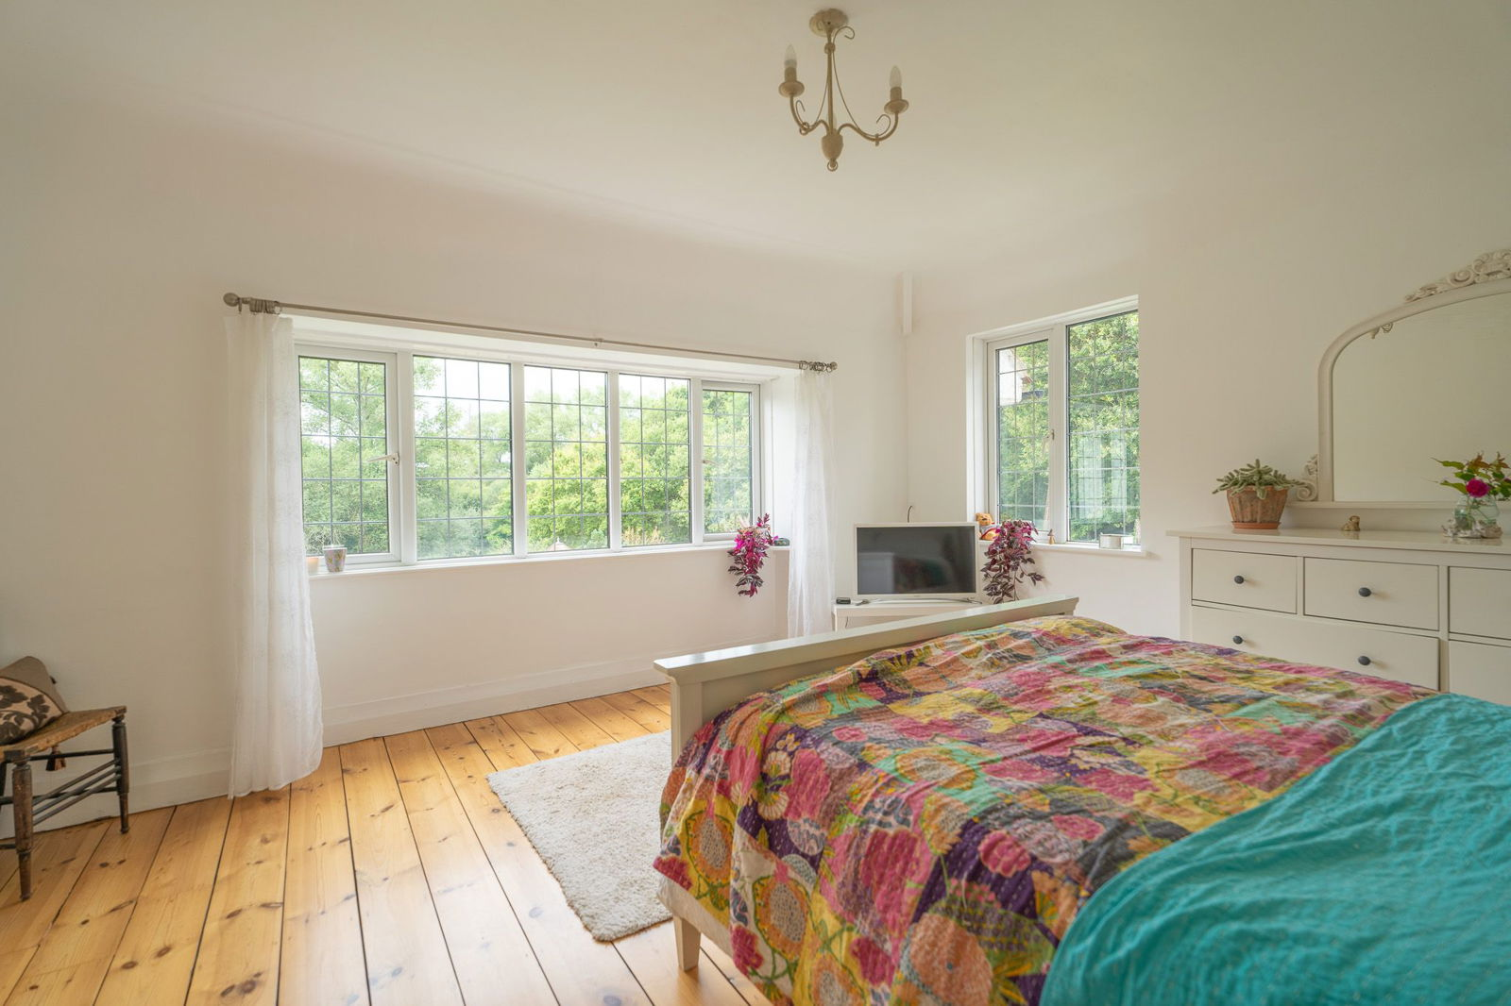
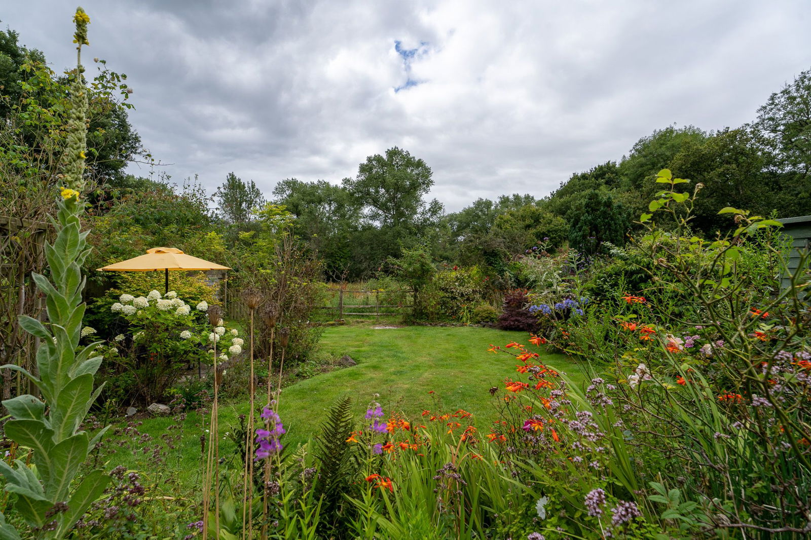
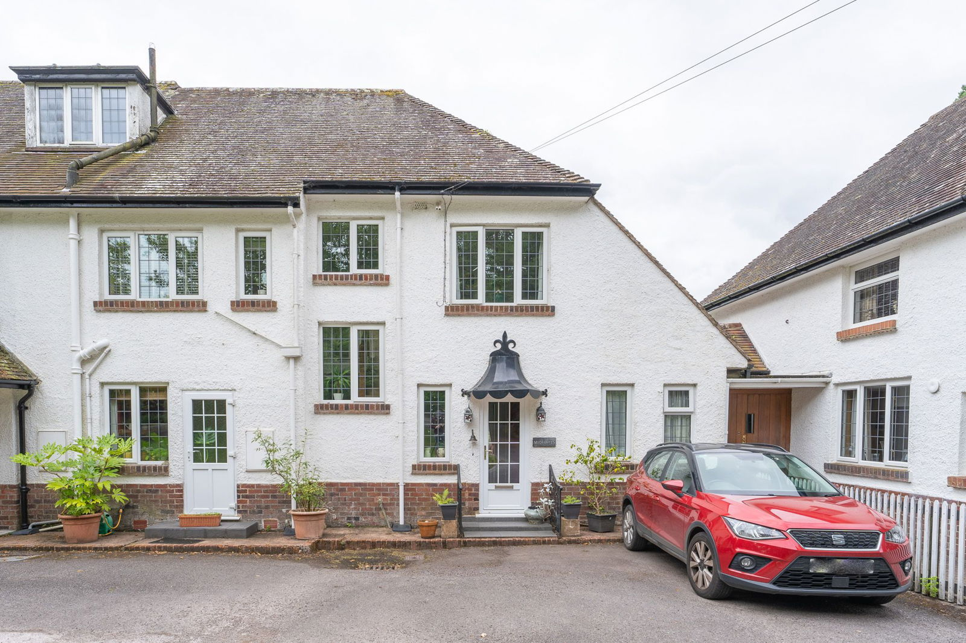
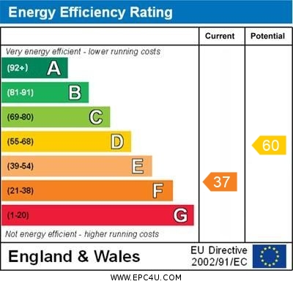
www.pennys.net
Midhayes, Marley Hayes, Exmouth, EX8 5DH
GUIDE PRICE £470,000
A Wonderful Semi Detached Period Property Located In A Semi Rural Location With Characterful, Well Presented Accommodation
Dual Aspect Lounge * Spacious Separate Dining Room * Cottage Style Kitchen * Separate Utility Room * Ground Floor Cloakroom/Wc * Three First Floor Bedrooms * Spacious Modern Bathroom Suite * Generously Sized Gardens Adjoining Woodland With A High Degree Of Privacy Viewing Recommended
Pennys Estate Agents Limited for themselves and for the vendor of this property whose agents they are give notice that:- (1) These particulars do not constitute any part of an offer or a contract. (2) All statements contained in these particulars are made without responsibility on the part of Pennys Estate Agents Limited. (3) None of the statements contained in these particulars are to be relied upon as a statement or representation of fact. (4) Any intending purchaser must satisfy himself/herself by inspection or otherwise as to the correctness of each of the statements contained in these particulars. (5) The vendor does not make or give and neither do Pennys Estate Agents Limited nor any person in their employment has any authority to make or give any representation or warranty whatever in relation to this property.
PENNYS ESTATE AGENTS
2 Rolle House, Rolle Street, Exmouth, Devon, EX8 2SN
Tel: 01395 264111 EMail: help@pennys.net

Slide 2
Midhayes, Marley Hayes, Exmouth, EX8 5DH
We are delighted to offer this attractive period property located within the tranquil leafy setting on the rural fringe of Exmouth enjoying a South-West facing private garden, the property offers spacious bright accommodation full of character and charm. A viewing of this individual property is highly recommended.
THE ACCOMMODATION COMPRISES: Entrance canopy with outside carriage light, uPVC double glazed front door to:
ENTRANCE HALL: With tiled floor, solid wood door to:
INNER HALLWAY: With radiator, staircase rising to first floor.
LOUNGE: 4.57m x 4.06m (15'0" x 13'4") Excluding wall recesses which are fitted with shelving units and cabinet, bright dual aspect room with uPVC double glazed window to side aspect and sliding double glazed patio doors opening onto the rear garden, log burner stove set in chimney recess with oak beam over and standing on a slate hearth, radiator, coved ceiling, TV point.
DINING ROOM: 5.46m x 3.78m (17'11" x 12'5") Another spacious bright room with double glazed doors and picture windows opening and overlooking onto the rear garden, stripped wood flooring, radiator, coved ceiling.
KITCHEN: 3.43m x 2.9m (11'3" x 9'6") A farmhouse style kitchen with range of solid wood working surfaces with cupboards, drawer units, integrated dishwasher, fridge and freezer beneath work surface, inset Bosch induction hob with feature exposed brick wall behind and fitted shelf, built-in double oven, wall mounted cupboards, tiled surrounds, recessed ceiling spotlighting, radiator, uPVC double glazed window to front aspect, stripped wood flooring, uPVC double glazed door giving access to front aspect.
UTILITY ROOM: 2.06m x 1.65m (6'9" x 5'5") Fitted with worktop with Belfast style sink unit with mixer tap, plumbing for automatic washing machine, tiled splashback, tiled flooring, uPVC double glazed window.
From the reception hall, part glazed solid wood door to:
REAR PORCH: With uPVC double glazed double doors to rear garden, fitted storage cupboard and access to STORE CUPBOARD housing oil fired boiler for hot water and central heating, double glazed window and light connected.
GROUND FLOOR CLOAKROOM/WC: Fitted with pedestal wash hand basin with tiled splashback, WC, radiator, uPVC double glazed window.
FIRST FLOOR LANDING: Two uPVC double glazed windows.
BEDROOM 1: 4.22m x 3.94m (13'10" x 12'11") measurement excluding window and wall recesses. A charming and spacious, bright dual aspect bedroom with uPVC double glazed window to side and rear elevations, enjoying a pleasant rural outlook, stripped wood flooring, TV point, radiator, built-in wardrobe.
BEDROOM 2: 5.44m x 3.3m (17'10" x 10'10") Excluding wall recess, built-in wardrobes, TV point, radiator, uPVC double glazed window to rear aspect gaining lovely rural outlook.
BEDROOM 3: 3.15m x 2.87m (10'4" x 9'5") Built-in wardrobes, drawer units and cupboards, dressing table area, radiator, uPVC double glazed window to front elevation.
BATHROOM/WC: 2.87m x 2.26m (9'5" x 7'5") A spacious bathroom with modern suite comprising bath with Mira shower unit over, shower splash screen, wash hand basin with tiled splashback with fitted mirror front medicine cabinet over, WC with dual push button flush, two sets of uPVC double glazed windows, tiled flooring, chrome heated towel rail.
OUTSIDE: Enjoying a lovely rural setting, the property is approached along a private drive and approached by a driveway giving access to the property with parking area (there is an informal agreement to park in front of the property). The property’s main garden is to the rear of the property and benefits from lovely countryside views, the garden is mainly laid to lawn with an array of mature shrubs and plants offering a variety of colour. A raised patio area provides an excellent outside entertaining space. Garden shed, power at the bottom of the garden. In addition to the gardens there is a wooded area which offers timber built storage unit and hardstanding area ideal for boat/caravan.
LOCATION: The property lies on the fringe of Exmouth, in a most attractive sylvan setting within easy reach of Budleigh Salterton and Woodbury villages. Exmouth is surrounded by the beautiful Devon countryside yet is only 12 miles by road or rail from the Cathedral City of Exeter, with its Intercity railway station, airport, connection to the M5 motorway and all major shops and facilities. The town of Exmouth boasts over 3 miles of golden sands and a huge estuary and is well placed to take advantage of the numerous recreational facilities to be found by the Exe estuary and East Devon coastline, including the excellent facilities of Woodbury Park Golf and Country Club. A range of other amenities, including boating, sailing, water ski-ing, walking, a modern sports centre, swimming pool and marina are all available. Exmouth has its own thriving shopping centre and a variety of restaurants and other leisure opportunities.
DIRECTIONS: The property is located just passed Kings Garden Centre, taking the turning on the right into Marley Hayes.
AGENTS NOTE: The vendor has advised the following: oil storage tank (serving essential heating, boiler and hot water), mains electricity and water, wood burning stove. There is a private septic tank for the exclusive use of Midhayes, situated on the land within the ownership, this is currently emptied at 18 month intervals at a cost of approximately £180. The property is held on a 999 year lease from November 1972. There is no maintenance/service charges – repairs and maintenance are dealt with on an ad hoc basis. Buildings insurance is paid separately for each property. There is a peppercorn ground rent.

